Slide 1

<Customer Billing System>
SRM INSTITUTE OF SCIENCE AND TECHNOLOGY
FACULTY OF ENGINEERING AND TECHNOLOGY
DEPARTMENT OF NETWORKING AND COMMUNICATIONS
18CSC101J- MINI PROJECT
SACHIN KUMAR:RA2111026010118
YASWANTH KUMAR: RA21110260123
NIHITH PENUMUCHU: RA2111026010124
LIKITH BHARADWAJ:RA2111026010144
Branch: CSE w/s AI & ML
Section : T1
Batch No:02
Lab Instructor name: Dr. M. Shobana ma’am

Slide 2
Table of contents
Introduction
Objectives
Algorithm
Flowchart
Modules
Results and Discussion
Snapshots of the result
Sample Coding

Slide 3
Customer Billing System
Introduction:
Customer Billing System Project is a simple console application designed to demonstrate the practical use of C programming language and its features as wells as to generate an application which can be used in any departmental store, shops, cafes etc. for billing to the customer.
You can use this application to keep the records such as name, address, mobile number, paid amount, due amount, payment date etc. of your regular costumer. Moreover, if you have a new customer, you can add and edit the account at any time.

Slide 4
Objectives
The main objectives of this project are listed as follows:
Proper management of customer billing system.
Add and maintain customer detail.
Can be useful for both manager and cashier.
Maximum providence of search options.
User friendly messages in the way for easy application of program.

Slide 5
ALGORITHM
Step 1 : Start
Step 2 :Display Main Menu as given below:
1. To Add Account on list
2. To Search Customer’s Account
3. Exit
Step 3 :Get the input choice from the user
Choice 1 - Call the function to add account on list
Choice 2 - Call the function to search customer’s account
Choice 3 - Call the function to exit the system
Step 4 : Output Generated is the text file
Step 5 : End

Slide 6
Flowchart
Start
Main Menu
1.Add Account
2.Search Account
3.Exit
Enter user data to create records
Search customer records and display
End

Slide 7
Modules
We will use 3 modules in this project. These are as follows:
Module 1: To add account
It can hold any number of accounts and account can be added to the program at any time.
The programming of simple calculations such as calculation of due amount, balance etc. have been embed in the code of project.
Module 2: To search account
The Customer Billing System project in C gives you the facility of searching the account by two ways, either by name of the customer or by the number of customer.
The due amount to be paid is shown as negative balance.
Module 3:To exit
If you have nothing to do with the program, you can directly exit from the main menu.

Slide 8
Results and Discussions
We have been able to design a Customer Billing System using C language.This system has features such as :
1.You can hold any number of accounts and account can be added to the program at any time.
2.The programming of simple calculations such as calculation of due amount, balance etc. have been embed in the code of project.
3.The due amount to be paid is shown as negative balance.
4.If you have nothing to do with the program, you can directly exit from the main menu.

Slide 9
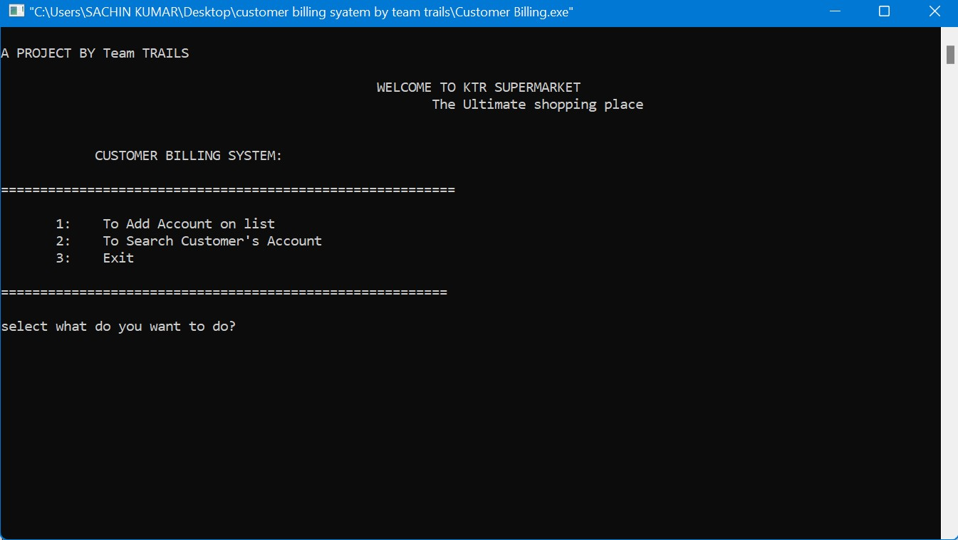
Snapshots Of the results
Main Menu

Slide 10
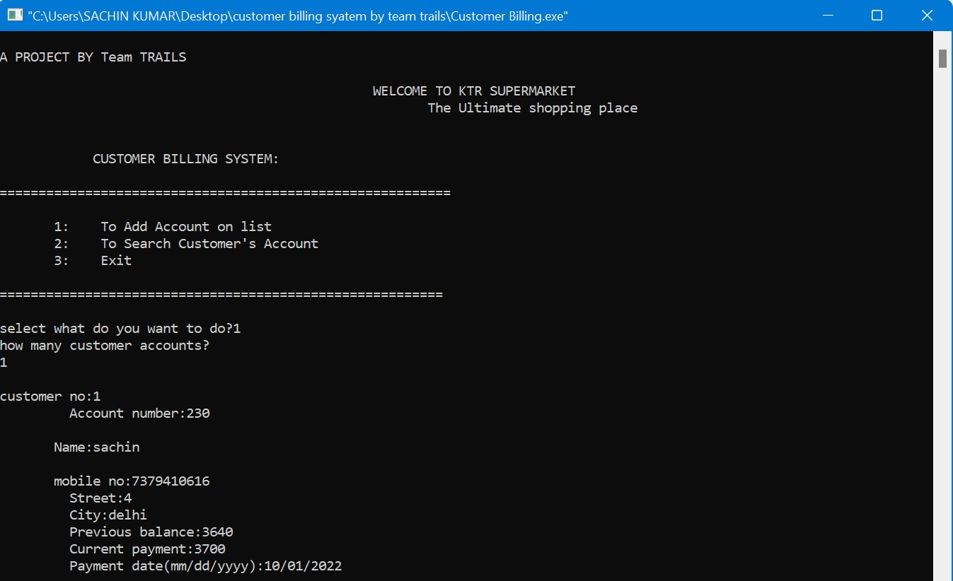
Snapshots Of the results
Choice 1:

Slide 11
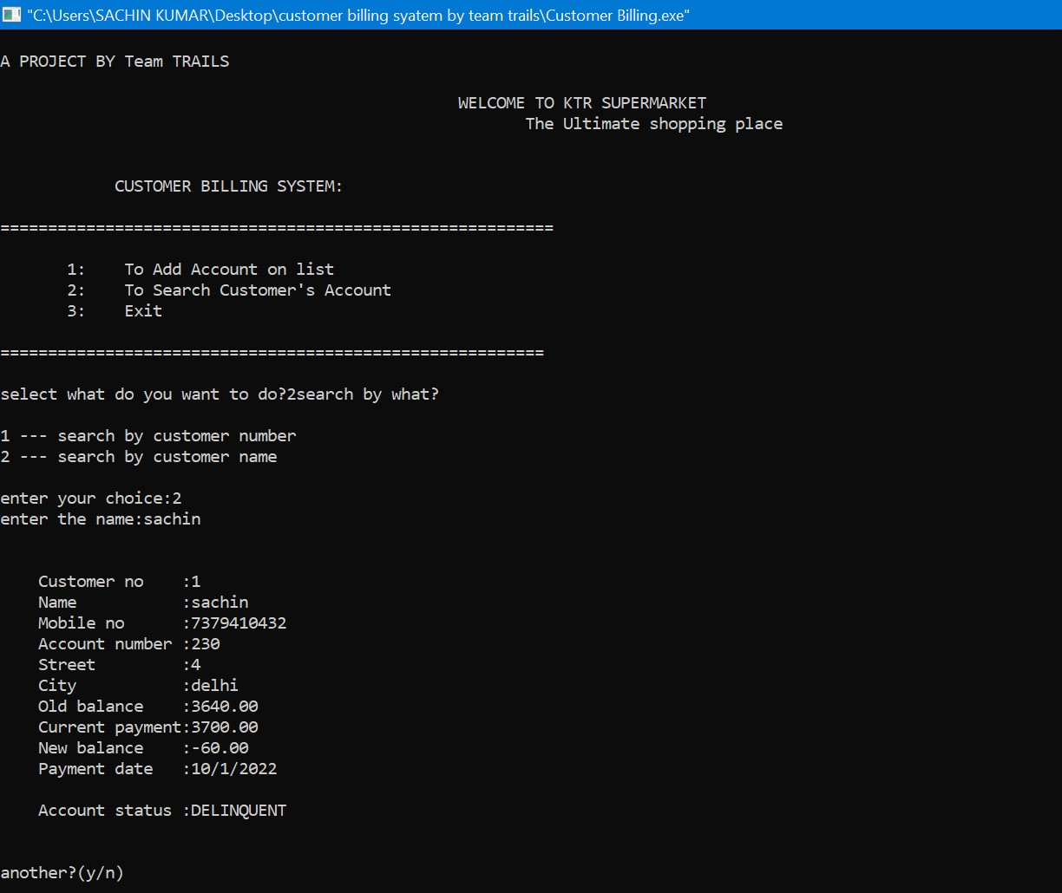
Snapshots Of the results
Choice 2:

Slide 12
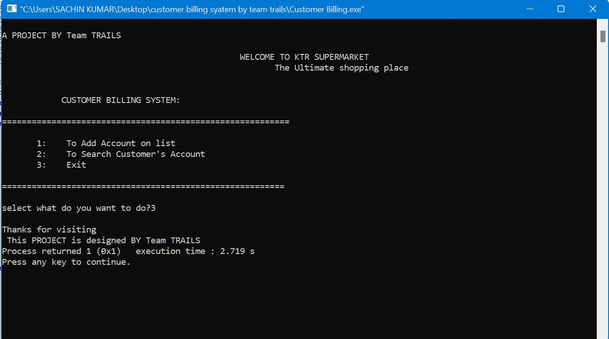
Snapshots Of the results
Choice 3:

Slide 13
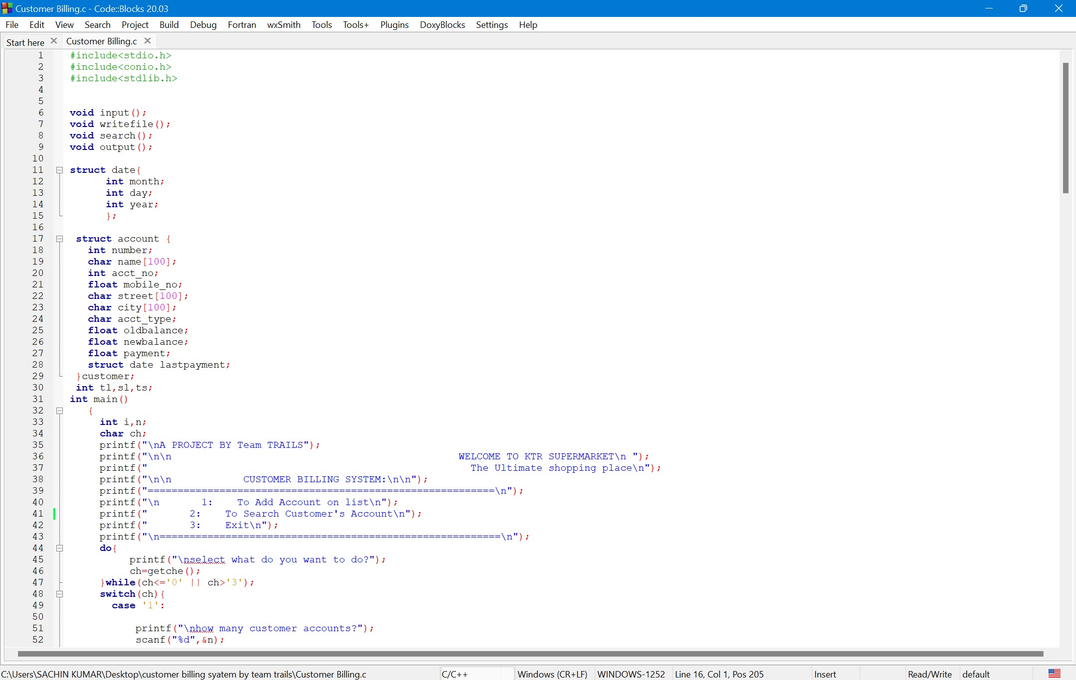
Sample coding

Slide 14
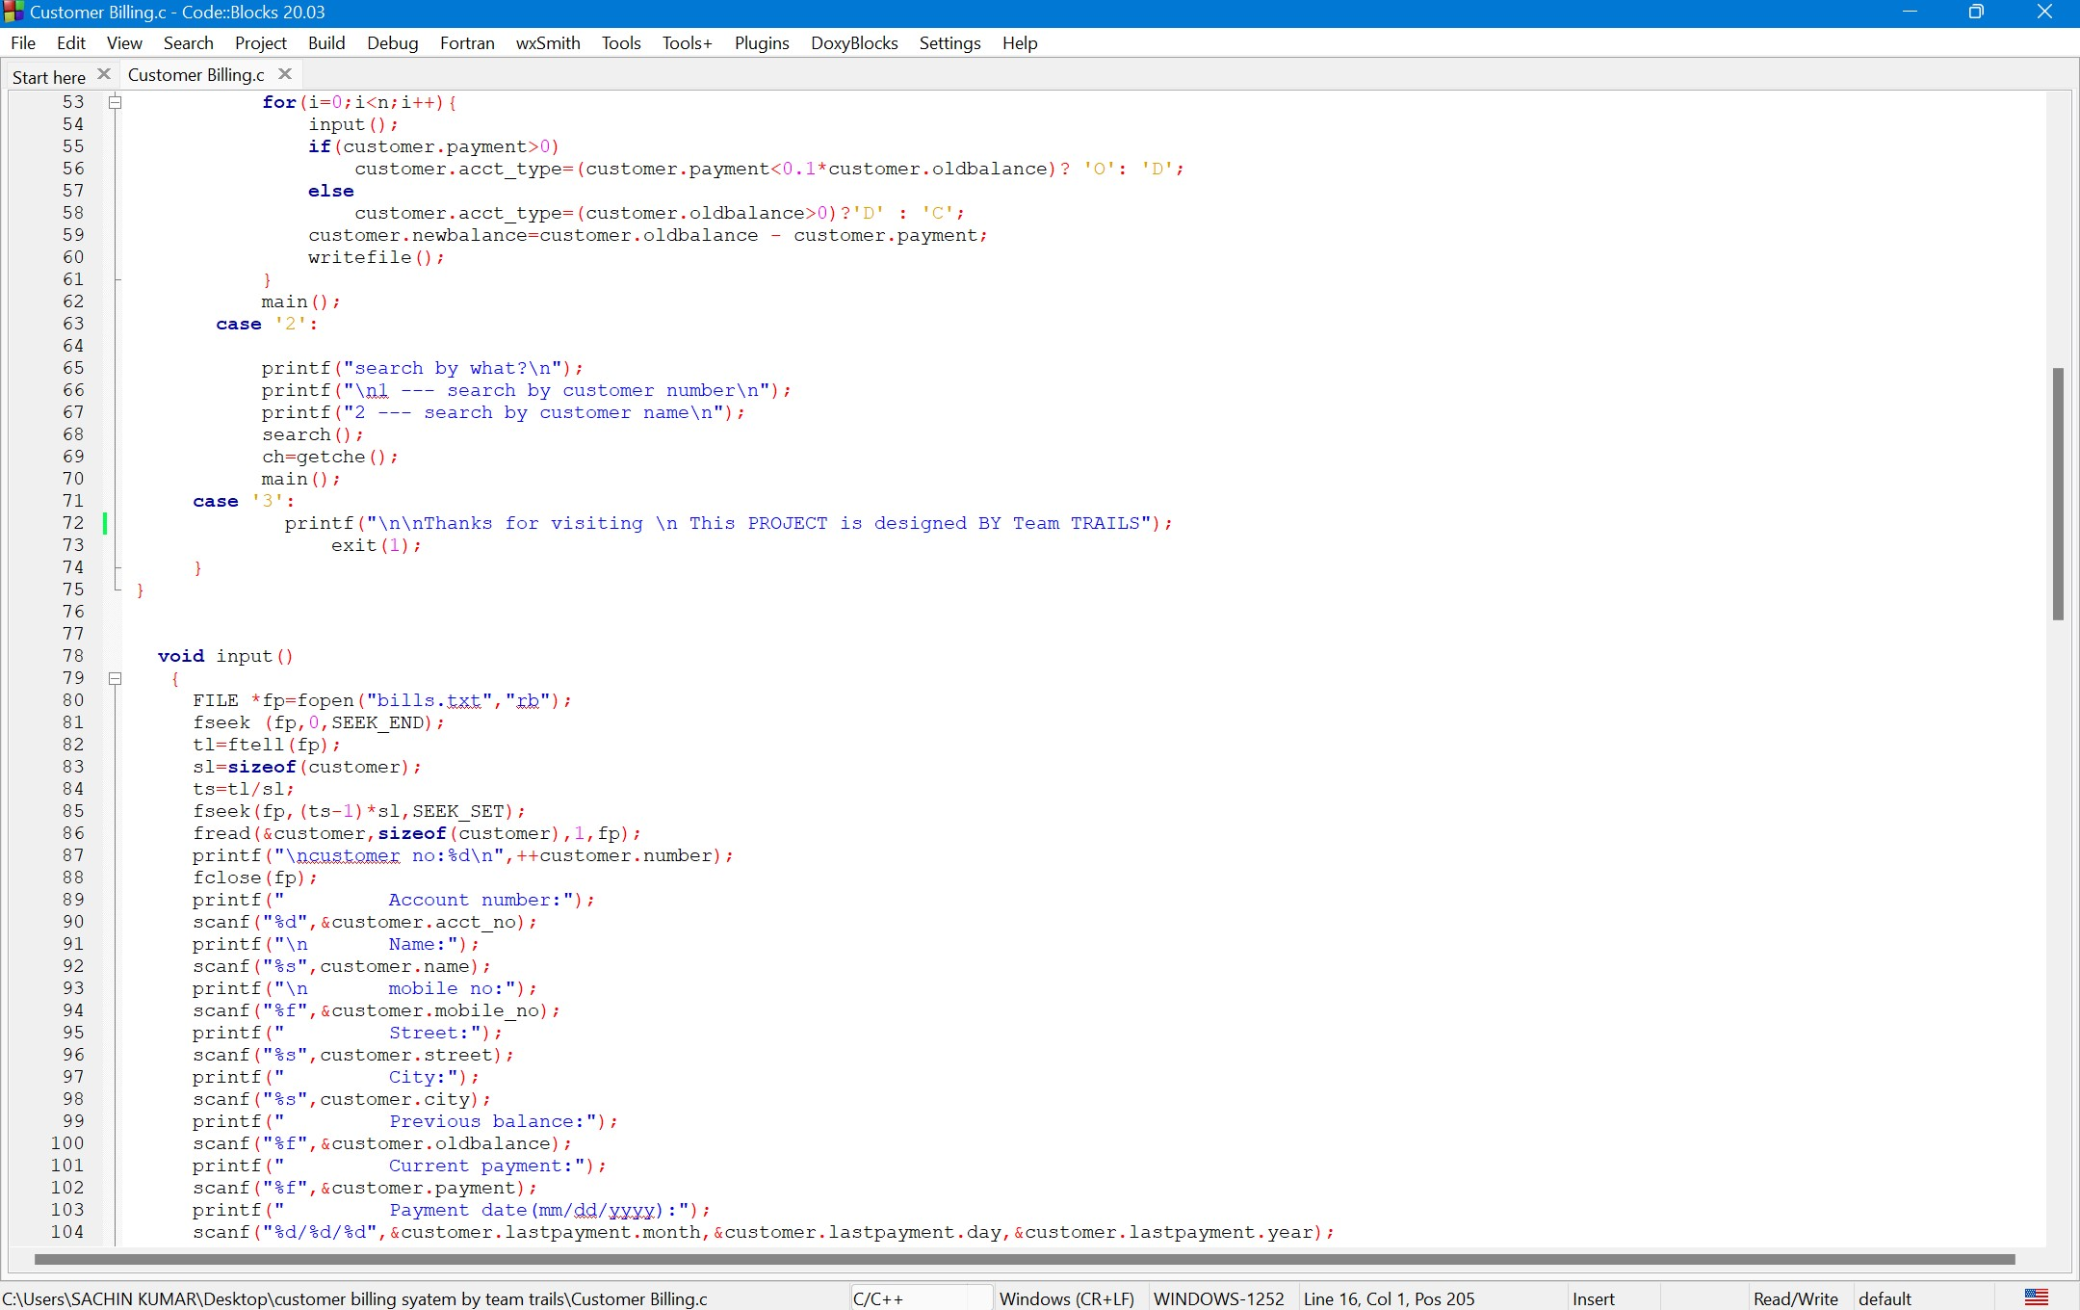
Sample coding

Slide 15
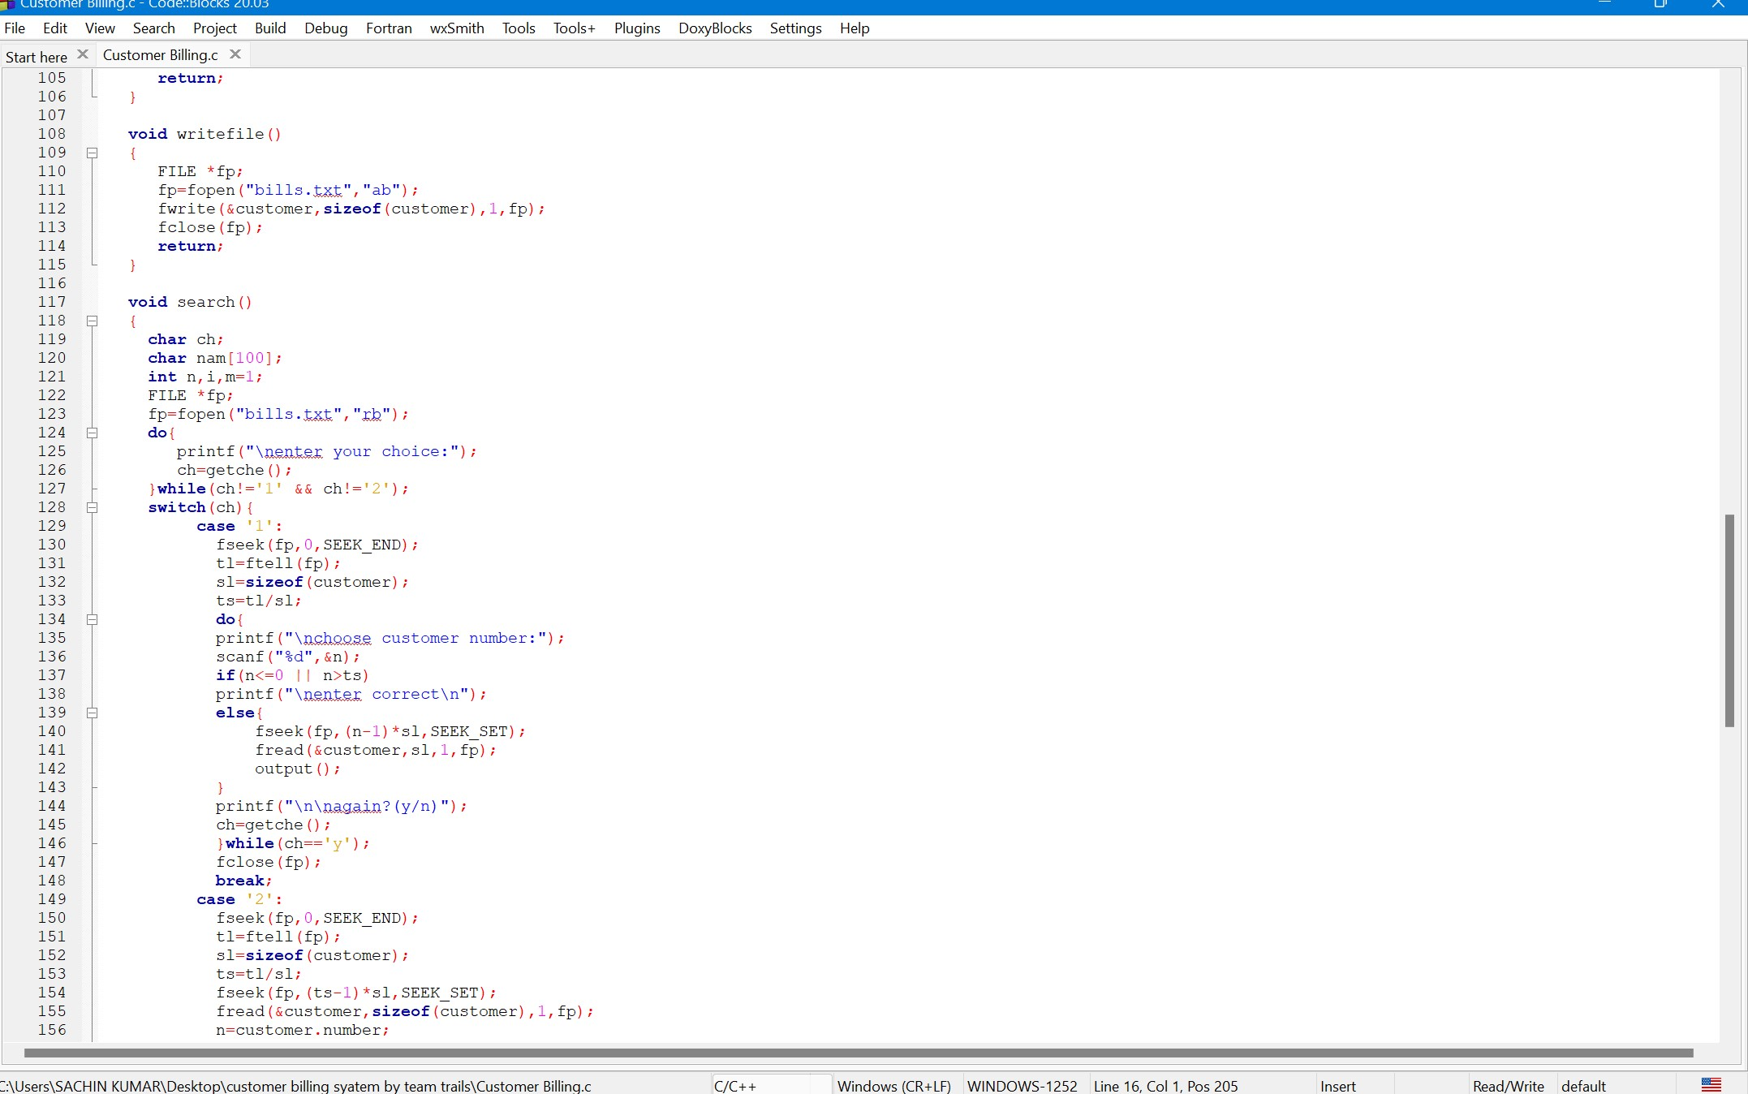
Sample coding

Slide 16
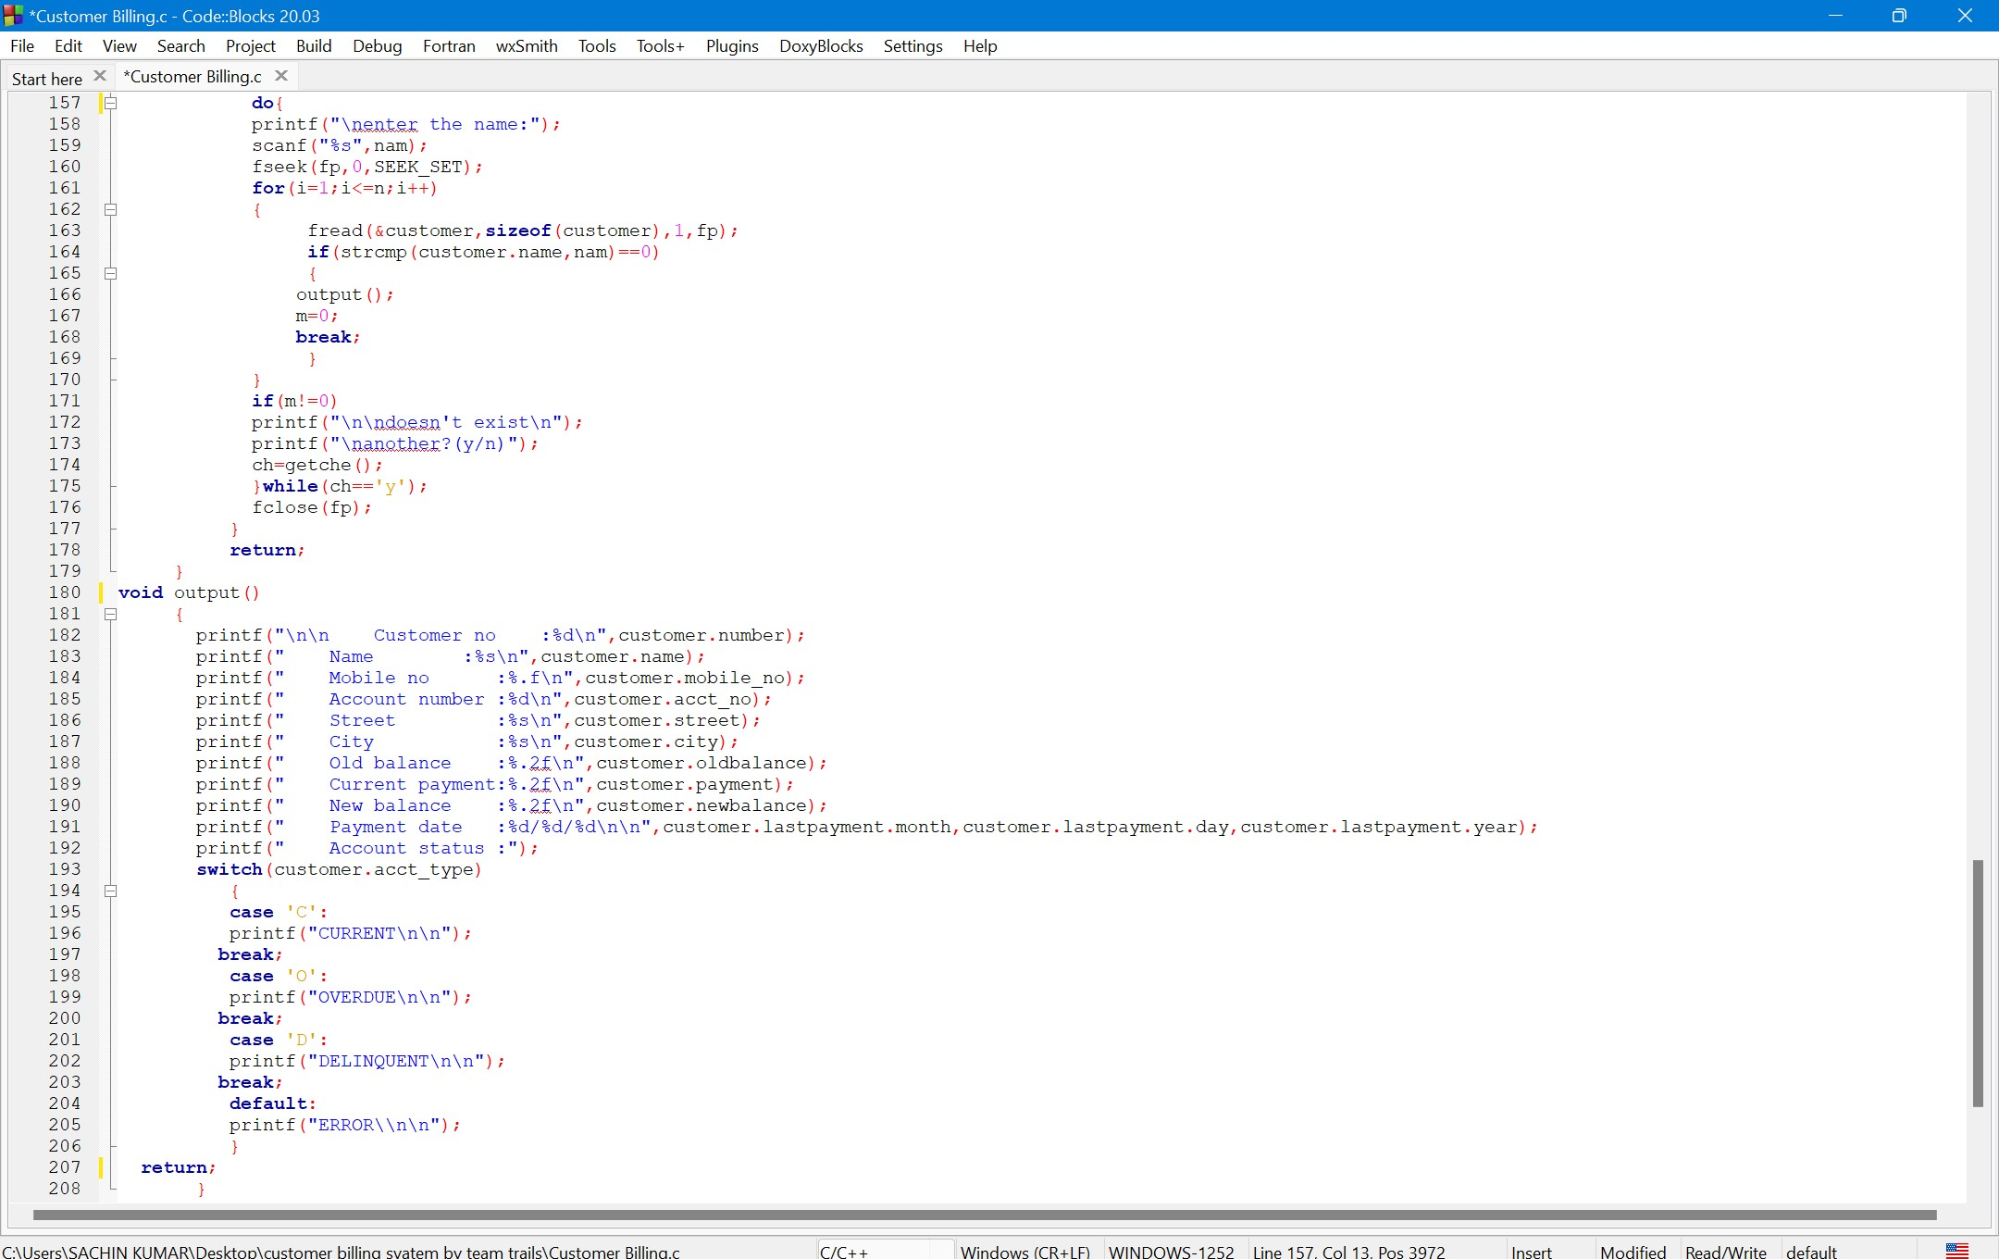
Sample coding

Slide 17
Thanks

